Slide 1

System Call
Nazneen Akhter ​
Assistant Professor​
Dept. of ICT​
Faculty of Science and Technology​
Bangladesh University of Professionals (BUP) ​
​
​
​
​

Slide 2
What is a system call?
A system call is a method for a computer program to request a service from the kernel of the operating system on which it is running.
A system call is a method of interacting with the operating system via programs
A system call is a request from computer software to an operating system's kernel
System calls are usually made when a process in user mode requires access to a resource

Slide 3
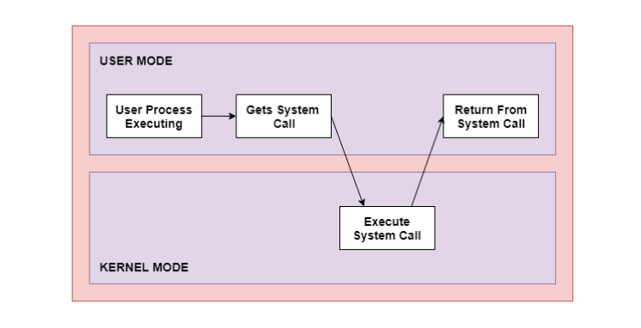
Cont..

Slide 4
Cont..
U
User Mode
Kernel Mode
Privileged mode

Slide 5
Cont..
The User mode is normal mode where the process has limited access
Kernel mode is the privileged mode where the process has unrestricted access to system resources like hardware, memory, etc.
A process can access I/O Hardware registers to program it, can execute OS kernel code and access kernel data in Kernel mode
Anything related to Process management, IO hardware management, and Memory management requires process to execute in Kernel mode

Slide 6
Why do you need system calls in operating system?
It is must require when a file system wants to create or delete a file
Network connections require the system calls to sending and receiving data packets
If you want to read or write a file, you need to system calls
If you want to access hardware devices, including a printer, scanner, you need a system call
System calls are used to create and manage new processes

Slide 7
How system calls work
The Applications run in an area of memory known as user space. A system call connects to the operating system's kernel, which executes in kernel space. When an application creates a system call, it must first obtain permission from the kernel. It achieves this using an interrupt request, which pauses the current process and transfers control to the kernel
If the request is permitted, the kernel performs the requested action, like creating or deleting a file. As input, the application receives the kernel's output. The application resumes the procedure after the input is received. When the operation is finished, the kernel returns the results to the application and then moves data from kernel space to user space in memory

Slide 8
Cont..
A simple system call may take few nanoseconds to provide the result, like retrieving the system date and time. A more complicated system call, such as connecting to a network device, may take a few seconds. Most operating systems launch a distinct kernel thread for each system call to avoid bottlenecks. Modern operating systems are multi-threaded, which means they can handle various system calls at the same time

Slide 9
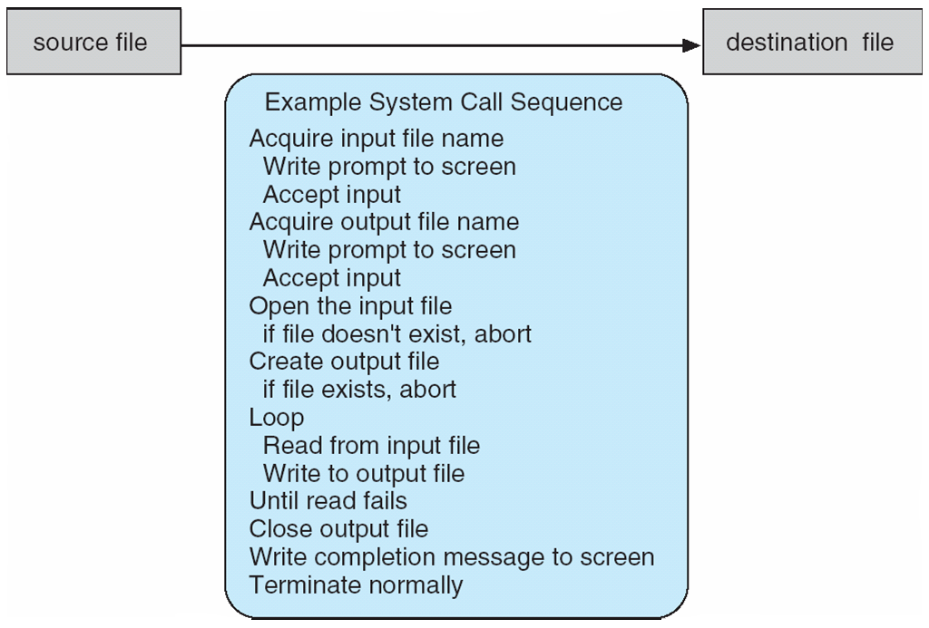
Example of system calls

Slide 10
System call implementation
Typically, a number associated with each system call
  – System-call interface maintains a table indexed according to these numbers
The system call interface invokes intended system call in OS kernel and returns status of the system call and any return values
The caller need know nothing about how the system call is implemented
  – Just needs to obey API and understand what OS will do as a result call
  – Most details of OS interface hidden from programmer by API
Managed by run-time support library (set of functions built into libraries included with compiler)

Slide 11
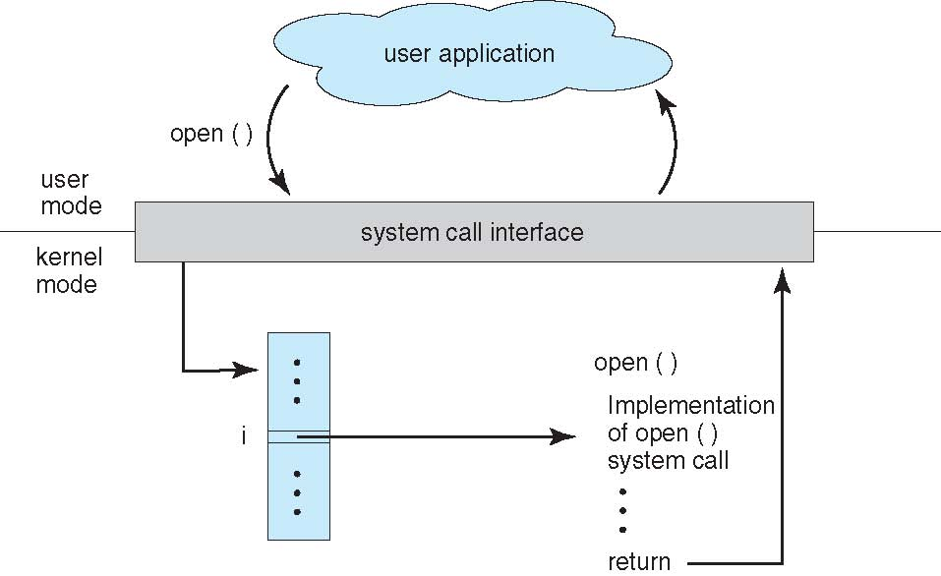
Cont..

Slide 12
System call parameter passing
Often, more information is required than simply identity of desired system call
– Exact type and amount of information vary according to OS and call
Three general methods used to pass parameters to the OS
1. Simplest: pass the parameters in registers
• In some cases, may be more parameters than registers

Slide 13
Cont..
2. Parameters stored in a block, or table, in memory, and address of block passed as a parameter in a register
  • This approach taken by Linux and Solaris
3. Parameters placed, or pushed, onto the stack by the program and popped off the stack by the operating system
– Block and stack methods do not limit the number or length of parameters being passed

Slide 14
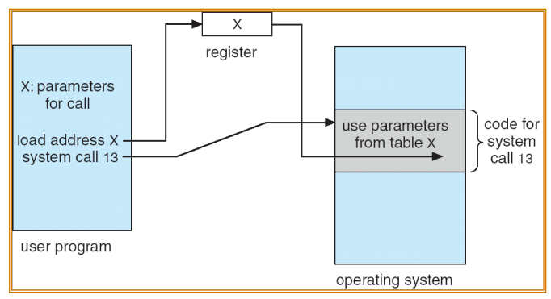
Parameter passing via table

Slide 15
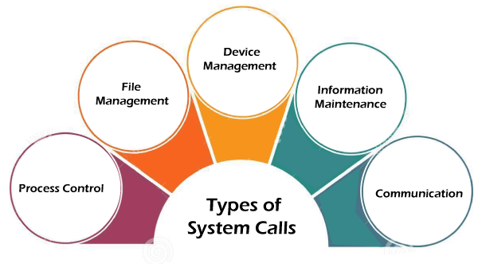
Types of System Calls

Slide 16
Types of system calls(cont..)
Process Control: process creation, process termination etc.
File Management: file manipulation such as creating a file, reading a file, writing into a file etc.
Device Management: device manipulation such as reading from device buffers, writing into device buffers etc.
Information Maintenance: handle information and its transfer between the operating system and the user program.
Communication: inter-process communication and also deal with creating and deleting a communication connection.

Slide 17
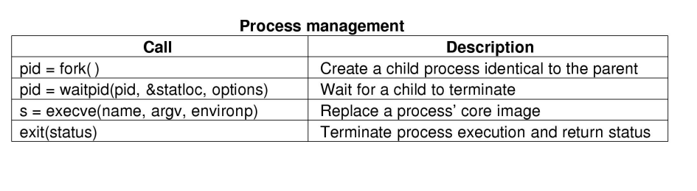
Sample of system calls

Slide 18
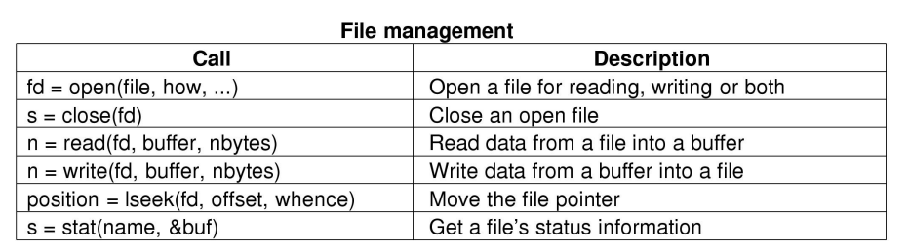
Cont..

Slide 19
Methods
open()
The open() system call allows you to access a file on a file system. It allocates resources to the file and provides a handle that the process may refer to. Many processes can open a file at once or by a single process only. It's all based on the file system and structure.

Slide 20
Cont..
read()
It is used to obtain data from a file on the file system. It accepts three arguments in general:
  A file descriptor.
  A buffer to store read data.
  The number of bytes to read from the file.
The file descriptor of the file to be read could be used to identify it and open it using open() before reading.

Slide 21
Cont..
wait()
In some systems, a process may have to wait for another process to complete its execution before proceeding. When a parent process makes a child process, the parent process execution is suspended until the child process is finished. The wait() system call is used to suspend the parent process. Once the child process has completed its execution, control is returned to the parent process.

Slide 22
Cont..
write()
It is used to write data from a user buffer to a device like a file. This system call is one way for a program to generate data. It takes three arguments in general:
  A file descriptor.
  A pointer to the buffer in which data is saved.
  The number of bytes to be written from the buffer.

Slide 23
Cont..
fork()
  Processes generate clones of themselves using the fork() system call. It is one of the most common ways to create processes in operating systems. When a parent process spawns a child process, execution of the parent process is interrupted until the child process completes. Once the child process has completed its execution, control is returned to the parent process.

Slide 24
Cont..
exec()
When an executable file replaces an earlier executable file in an already executing process, this system function is invoked. As a new process is not built, the old process identification stays, but the new process replaces data, stack, data, head, etc.

Slide 25
Cont..
exit()
The exit() is a system call that is used to end program execution. This call indicates that the thread execution is complete, which is especially useful in multi-threaded environments. The operating system reclaims resources spent by the process following the use of the exit() system function.

Slide 26
Cont..
close()
It is used to end file system access. When this system call is invoked, it signifies that the program no longer requires the file, and the buffers are flushed, the file information is altered, and the file resources are de-allocated as a result.

Slide 27

THANK YOU

